Slide 1
Machine learning approaches for Bayesian optimization of dynamic pathways
Charlotte Merzbacher
MSc Thesis
CDT in Biomedical AI

Slide 2
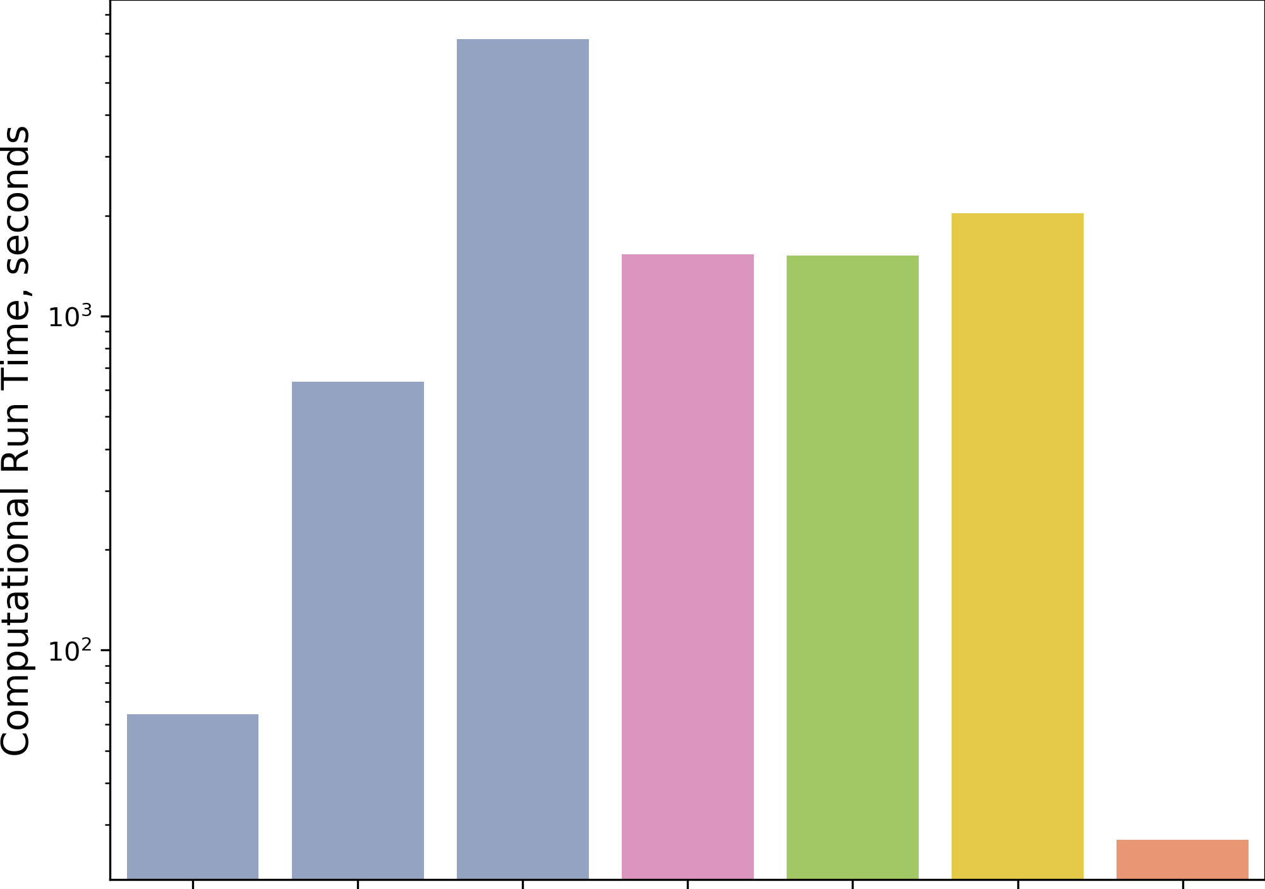
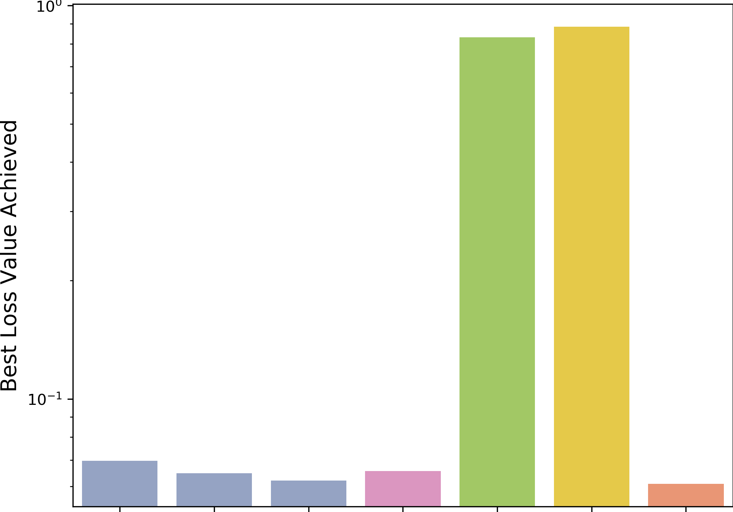
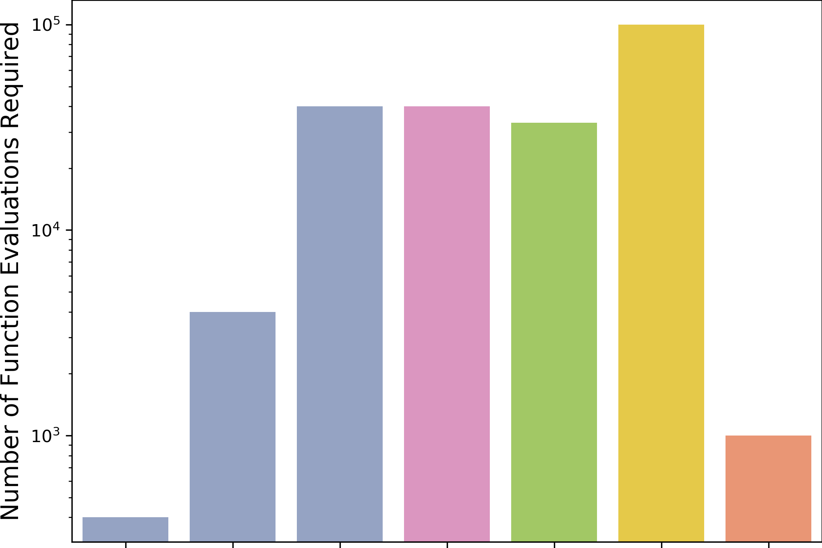
A
B
C
Naïve Approach
Exhaustive Search
Gradient-Based Optimization
Global Optimization
Bayesian Optimization

Slide 3
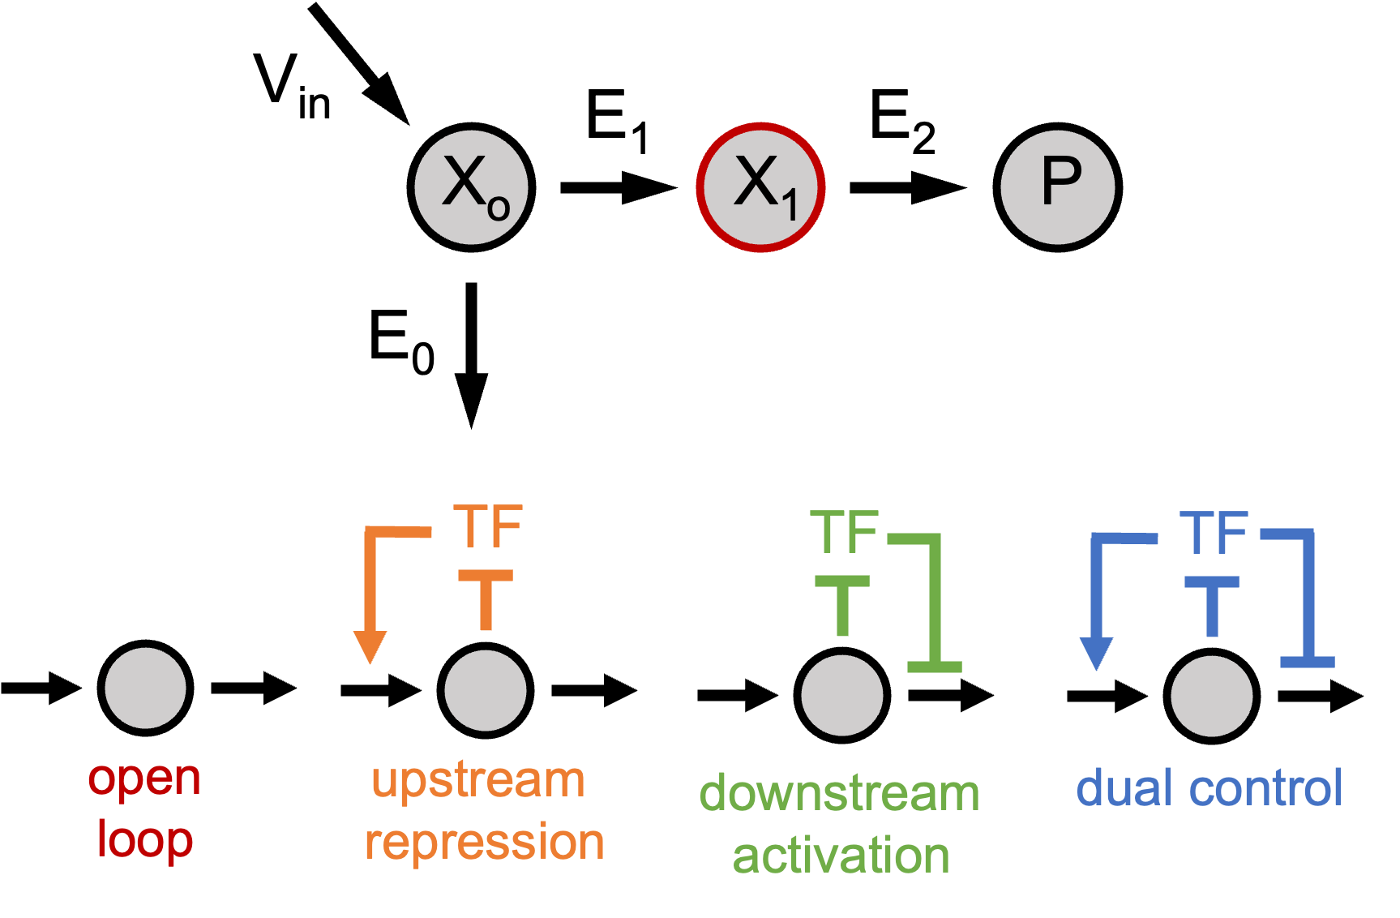
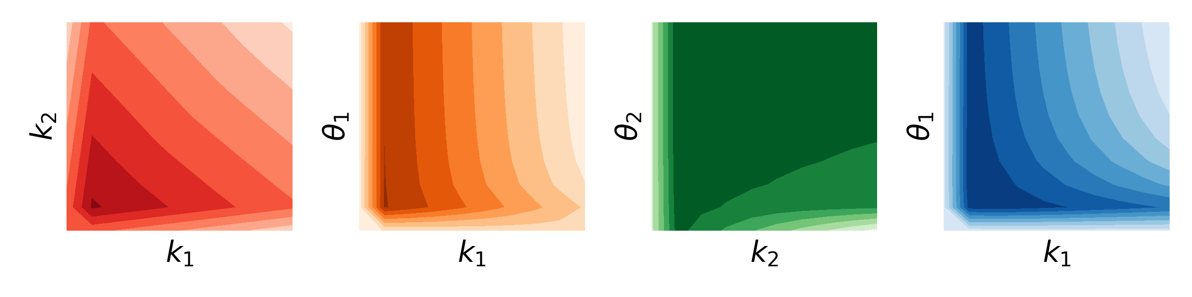
A
C
Sample parameter space
Solve ODE and compute objective function
Fit landscape with nonparametric model
B
Determine next sample balancing exploration and exploitation

Slide 4
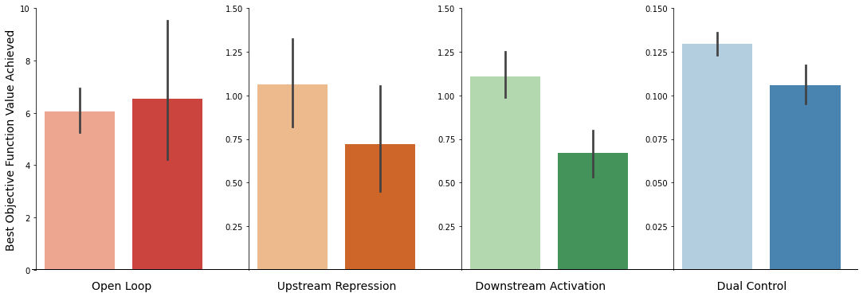
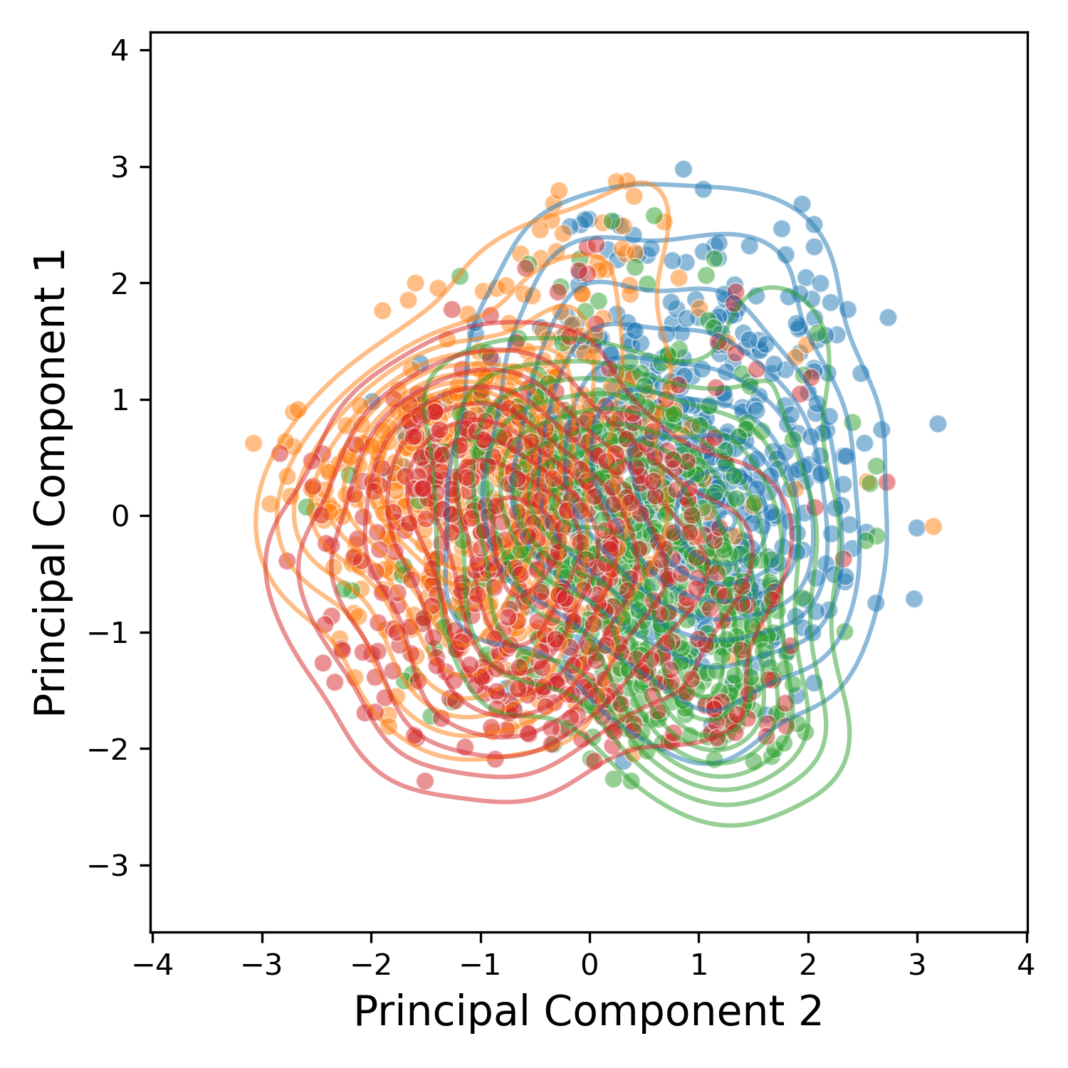
Perturbed
Background
C

Slide 5
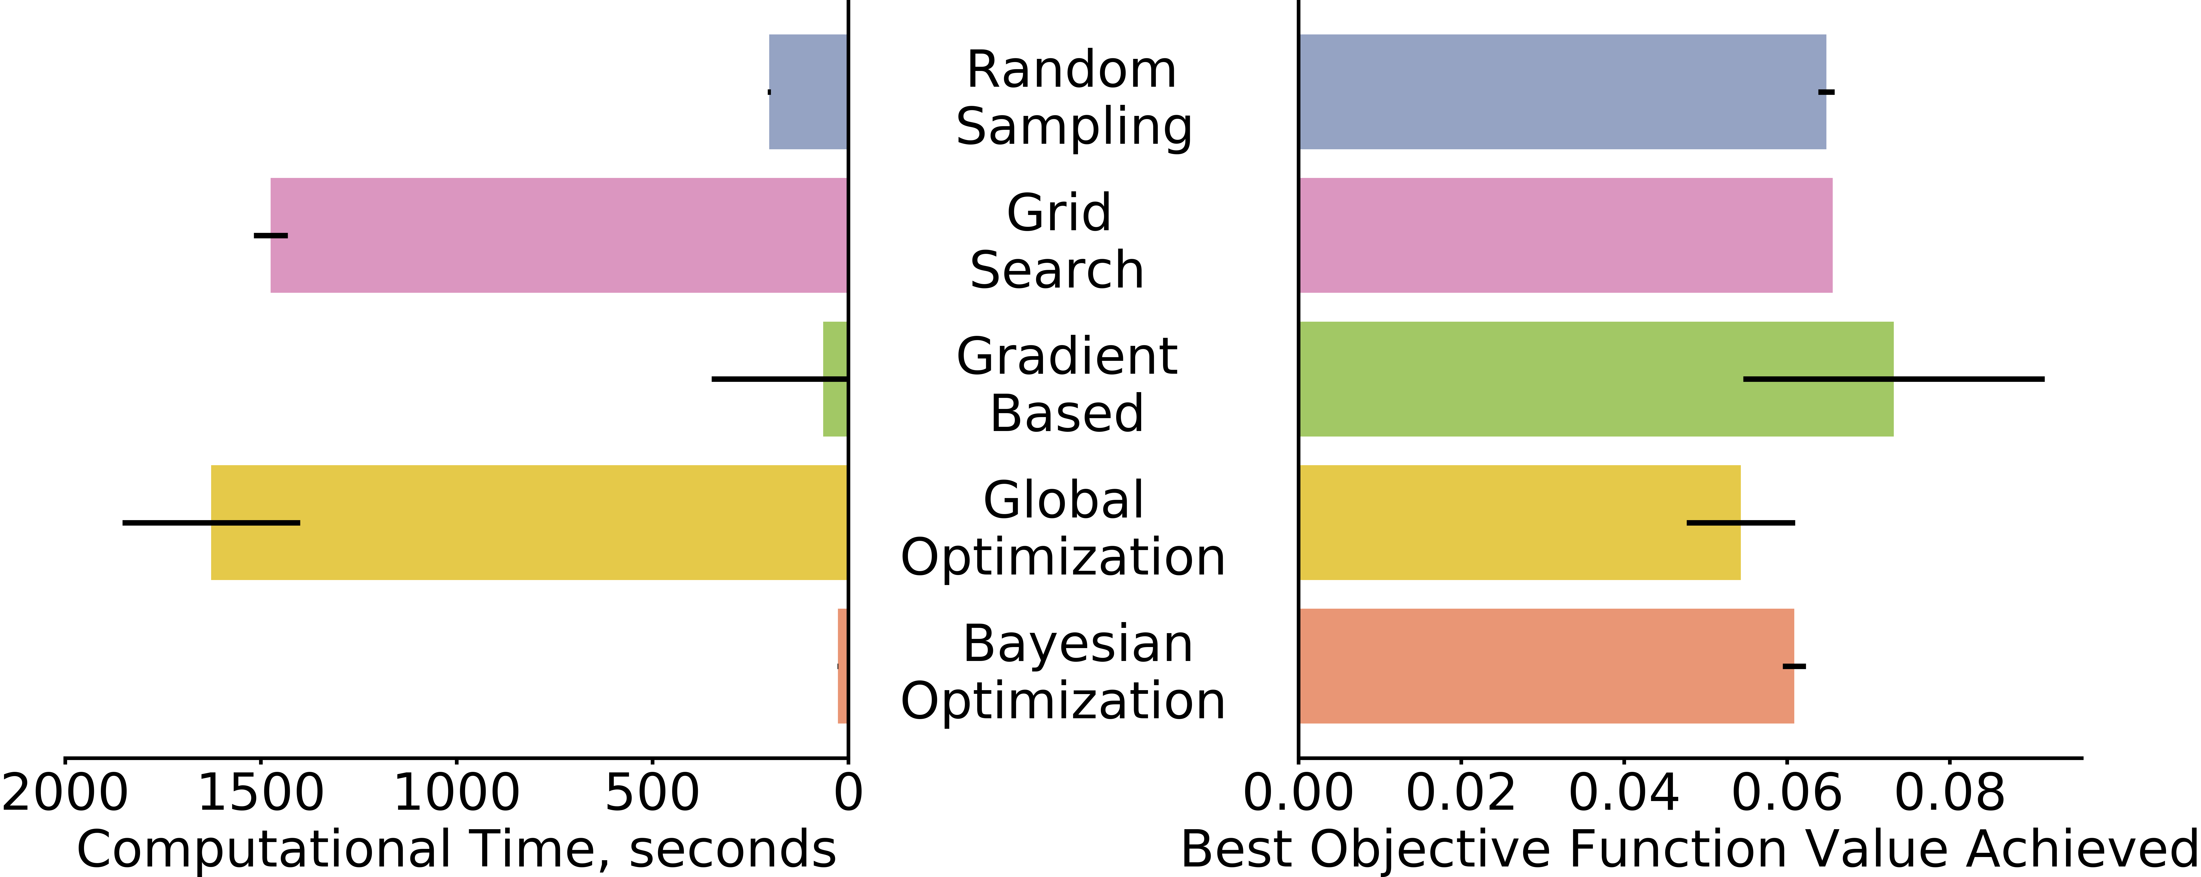

Slide 6
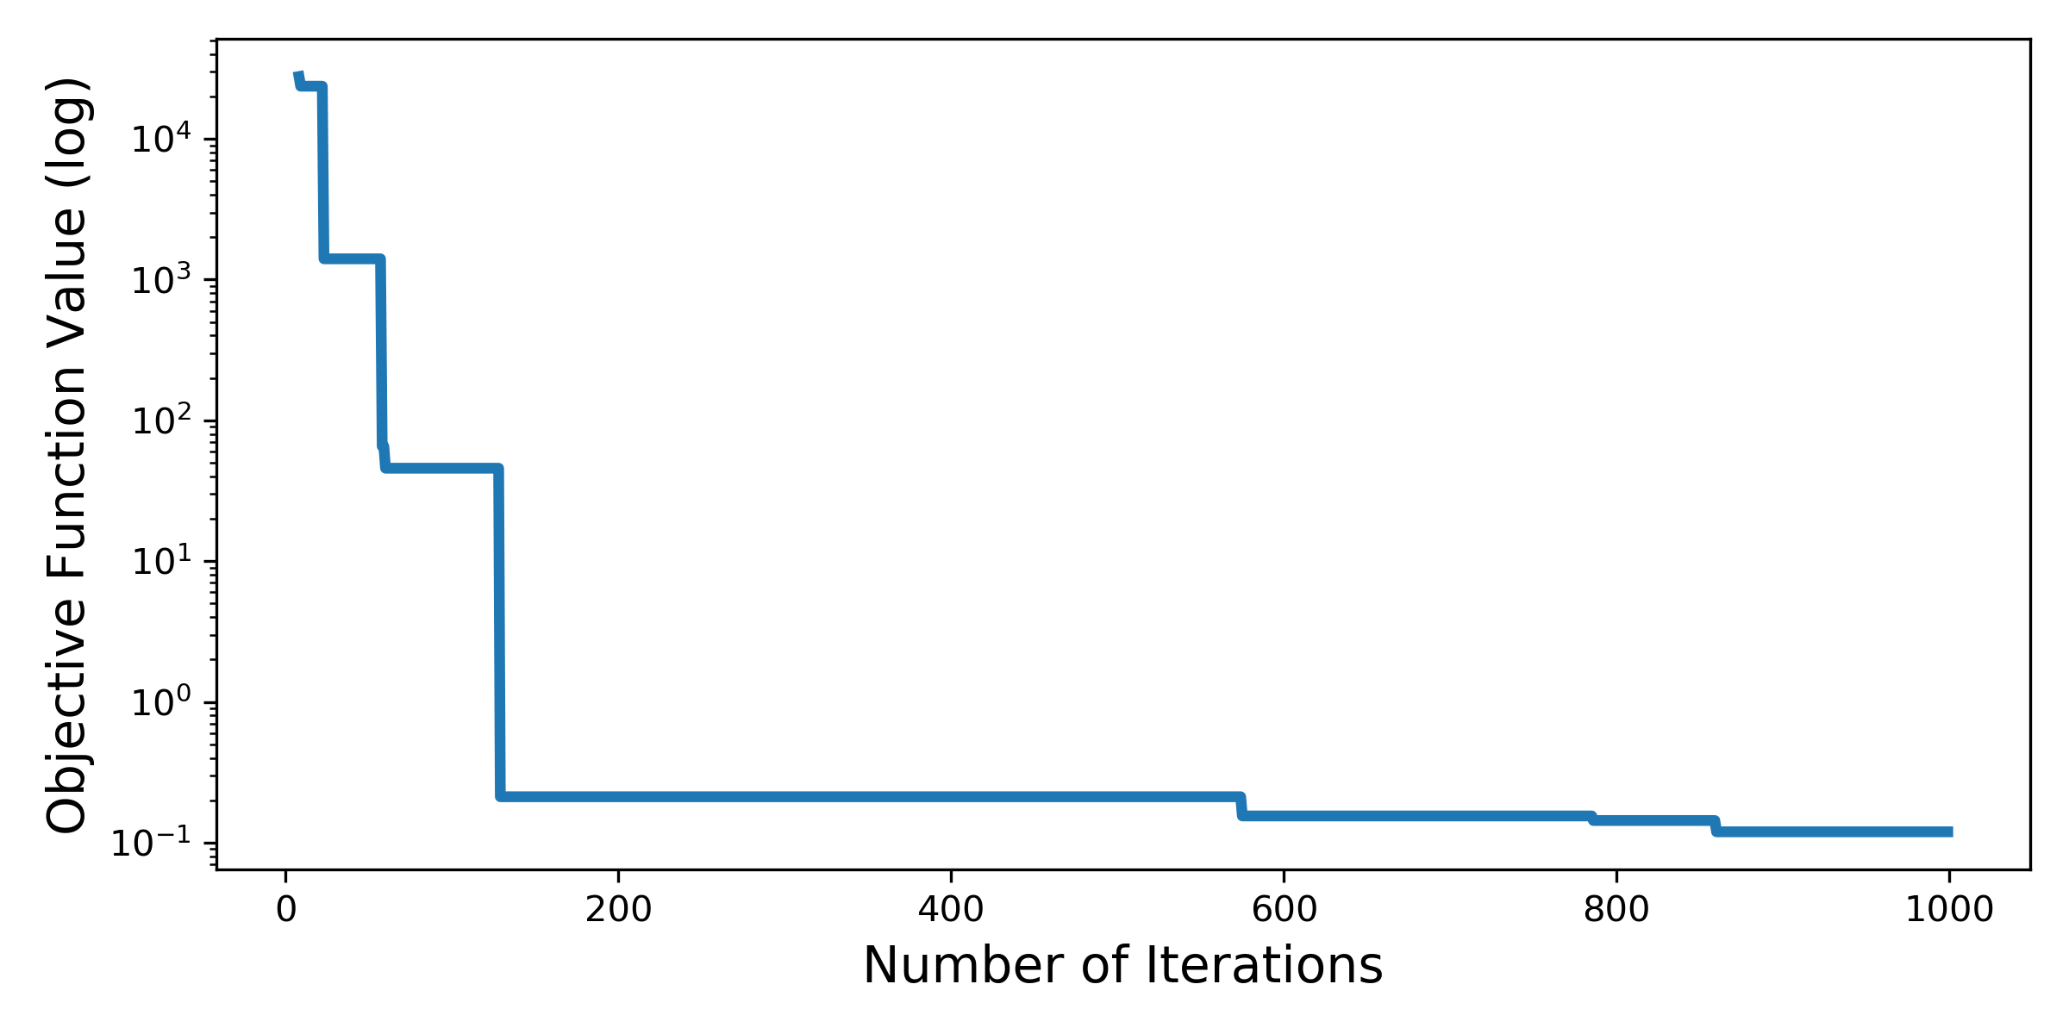
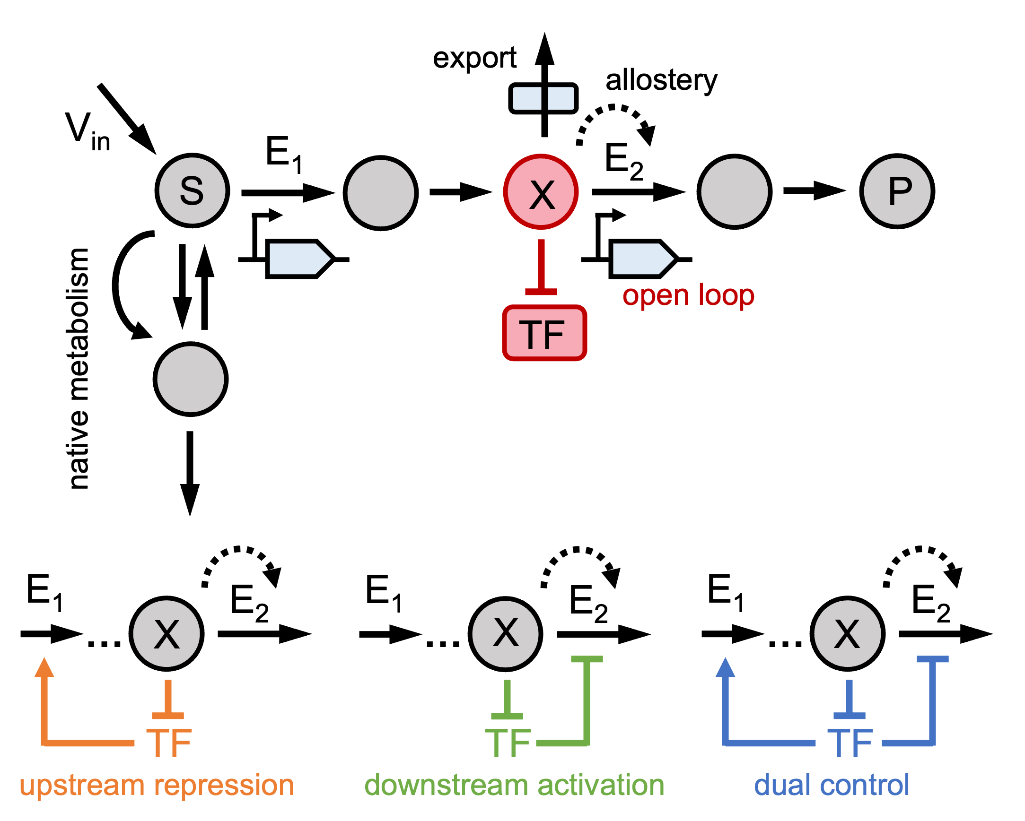
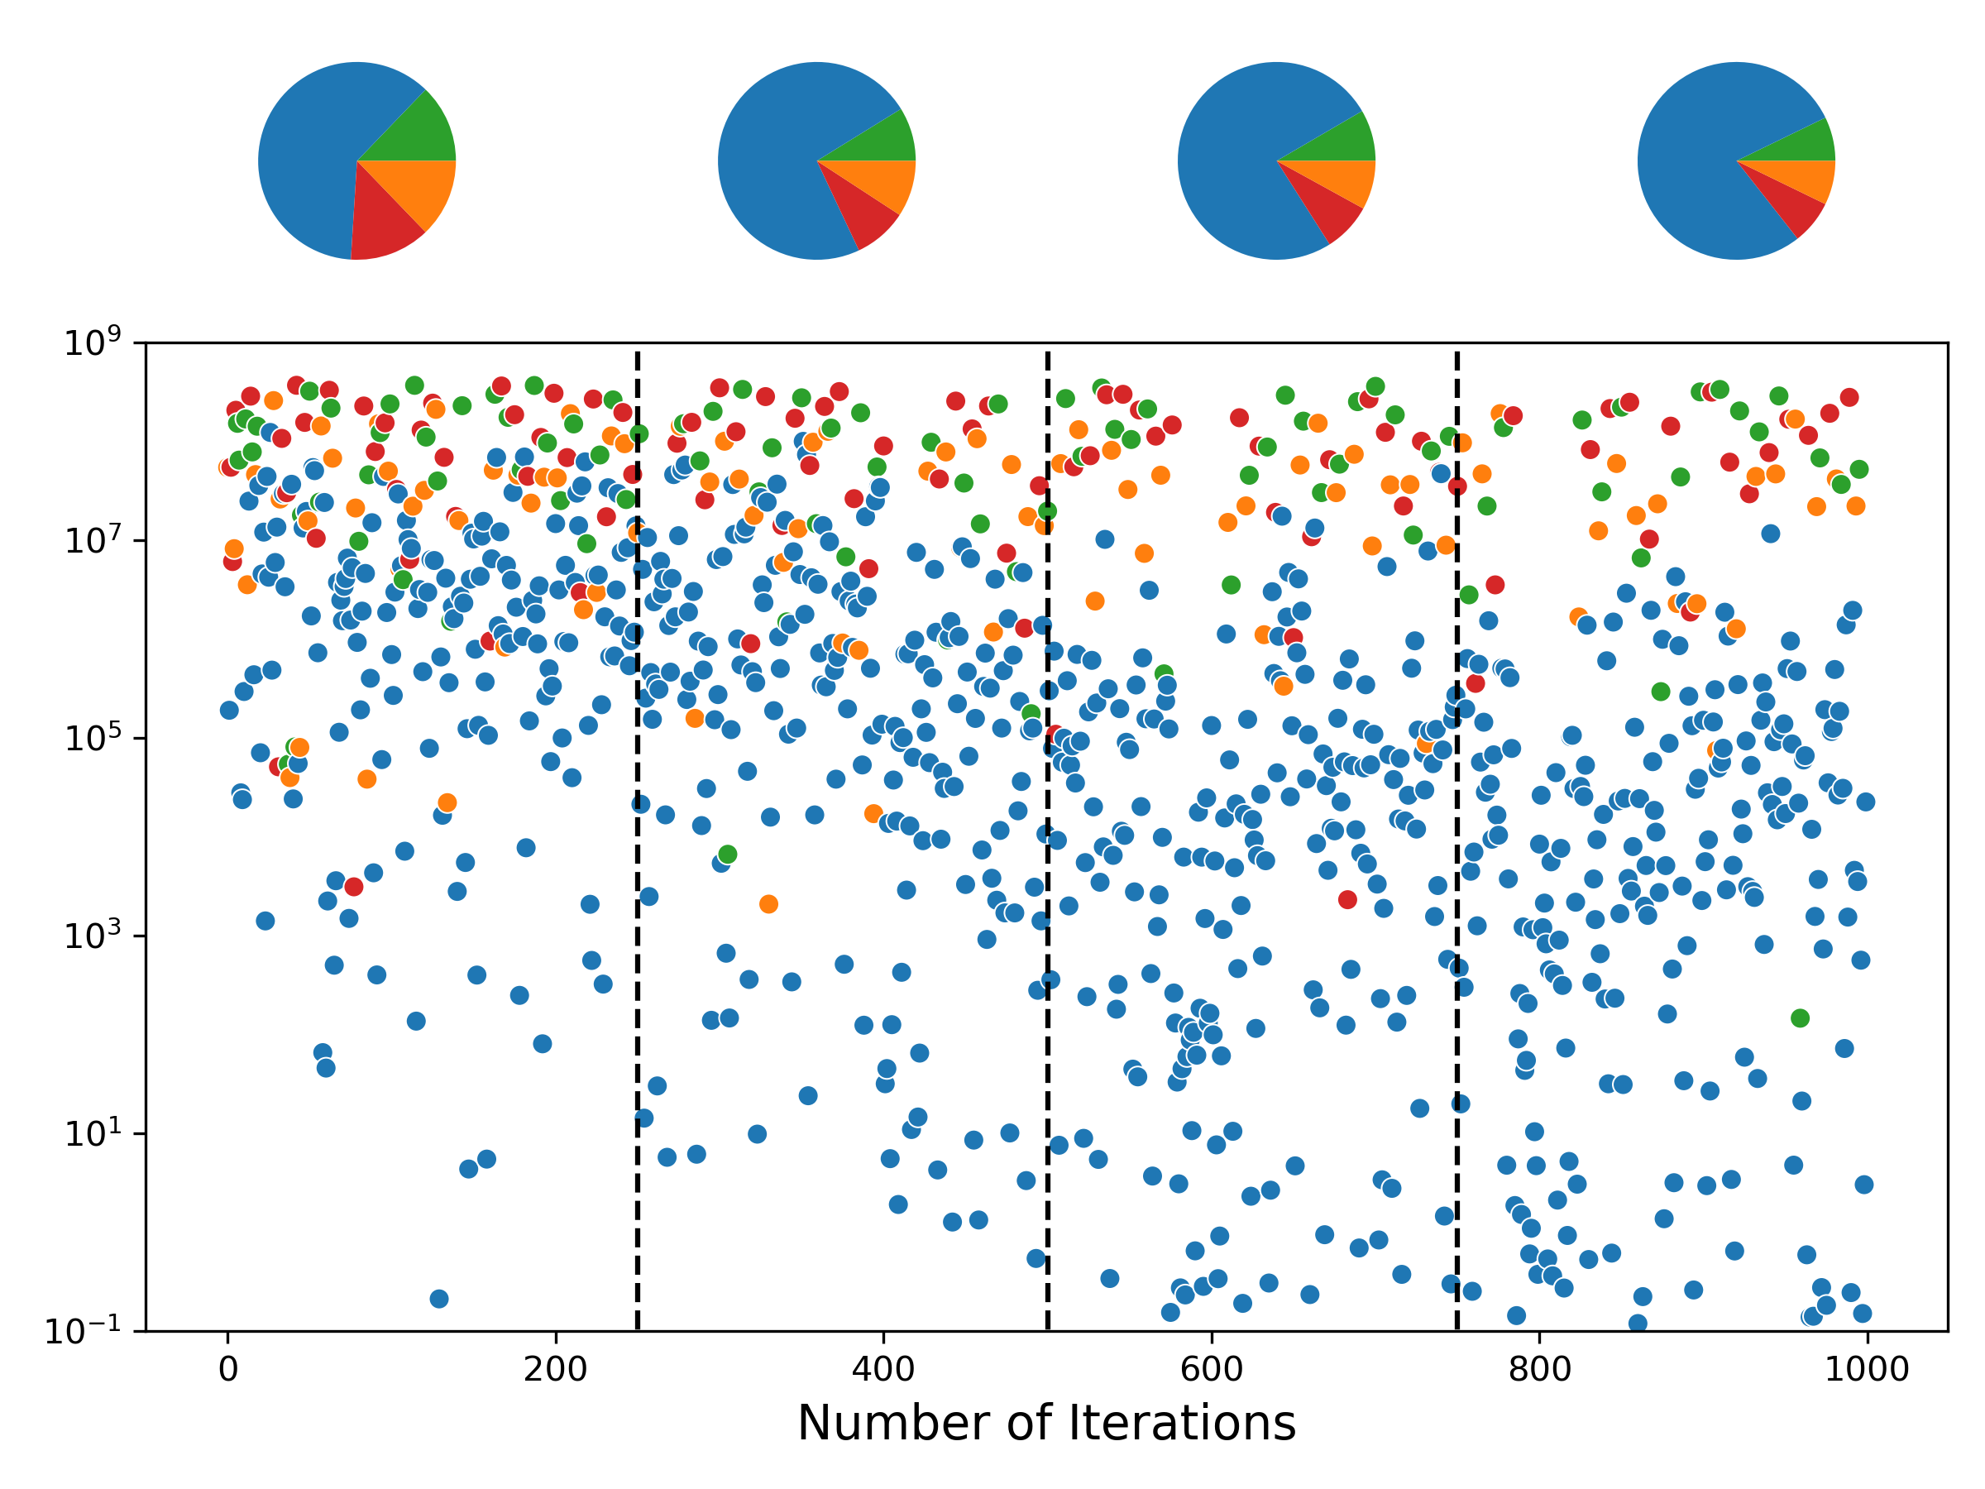
A
B
C

Slide 7
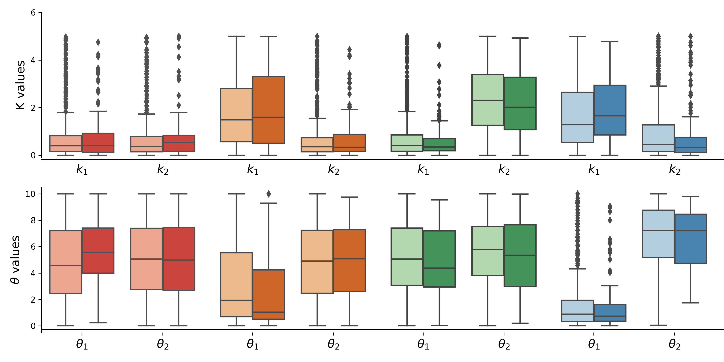
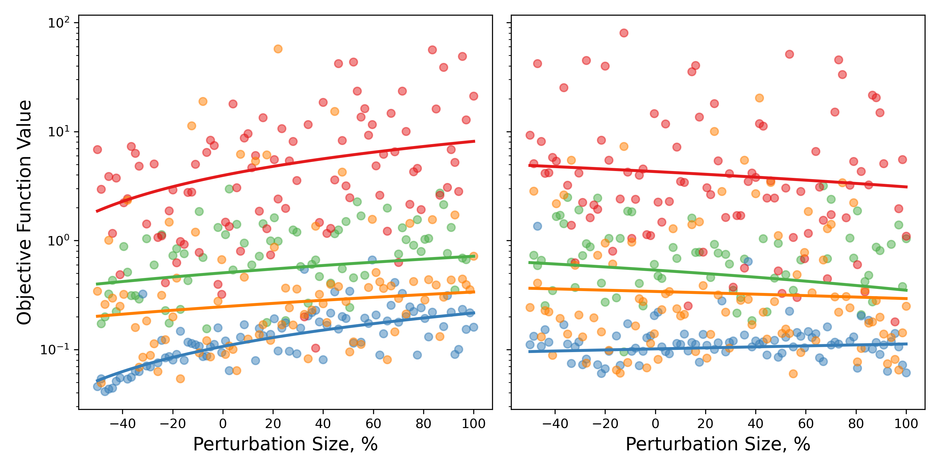
A
C
Open Loop
Upstream Repression
Downstream Activation
Dual Control
Perturbed
Background
B
D
Influx Perturbation
Export Perturbation

Slide 8
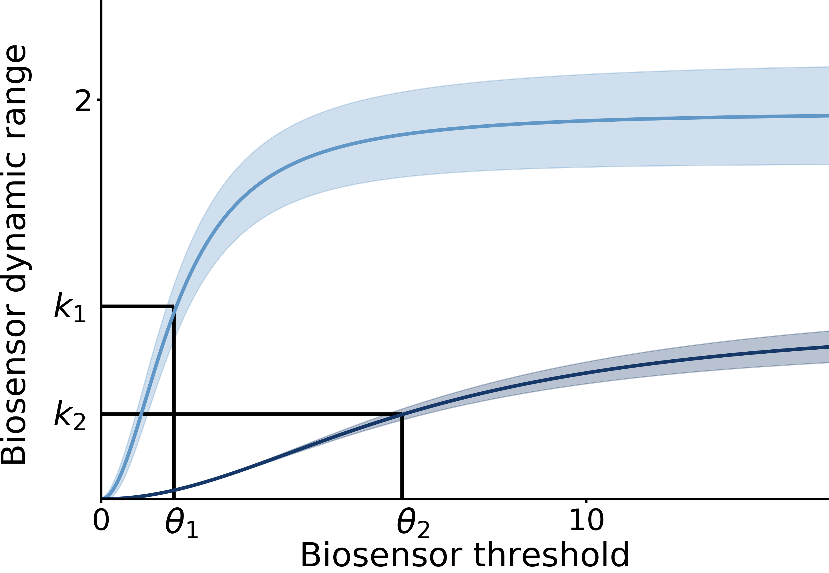
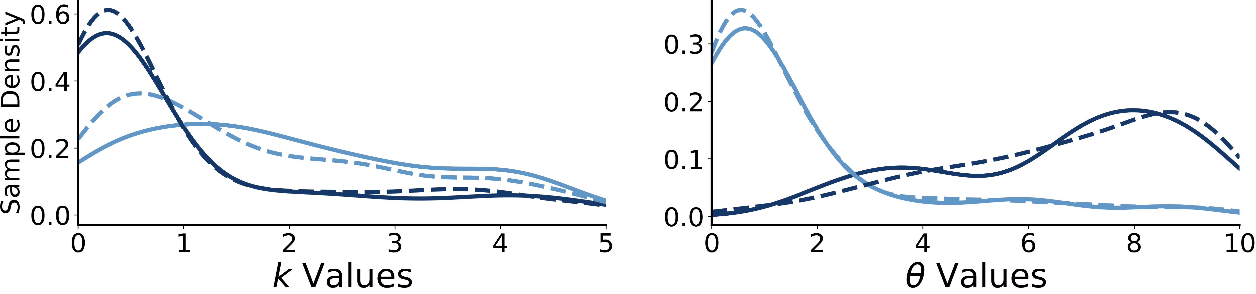
A
B
downstream loop
upstream loop
C
background
perturbed

Slide 10
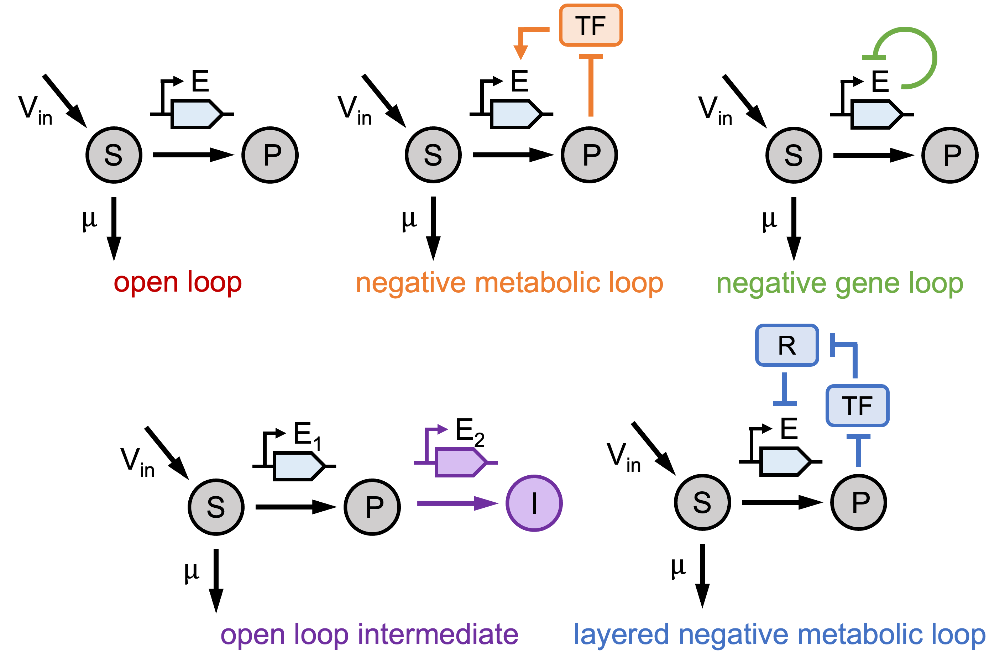
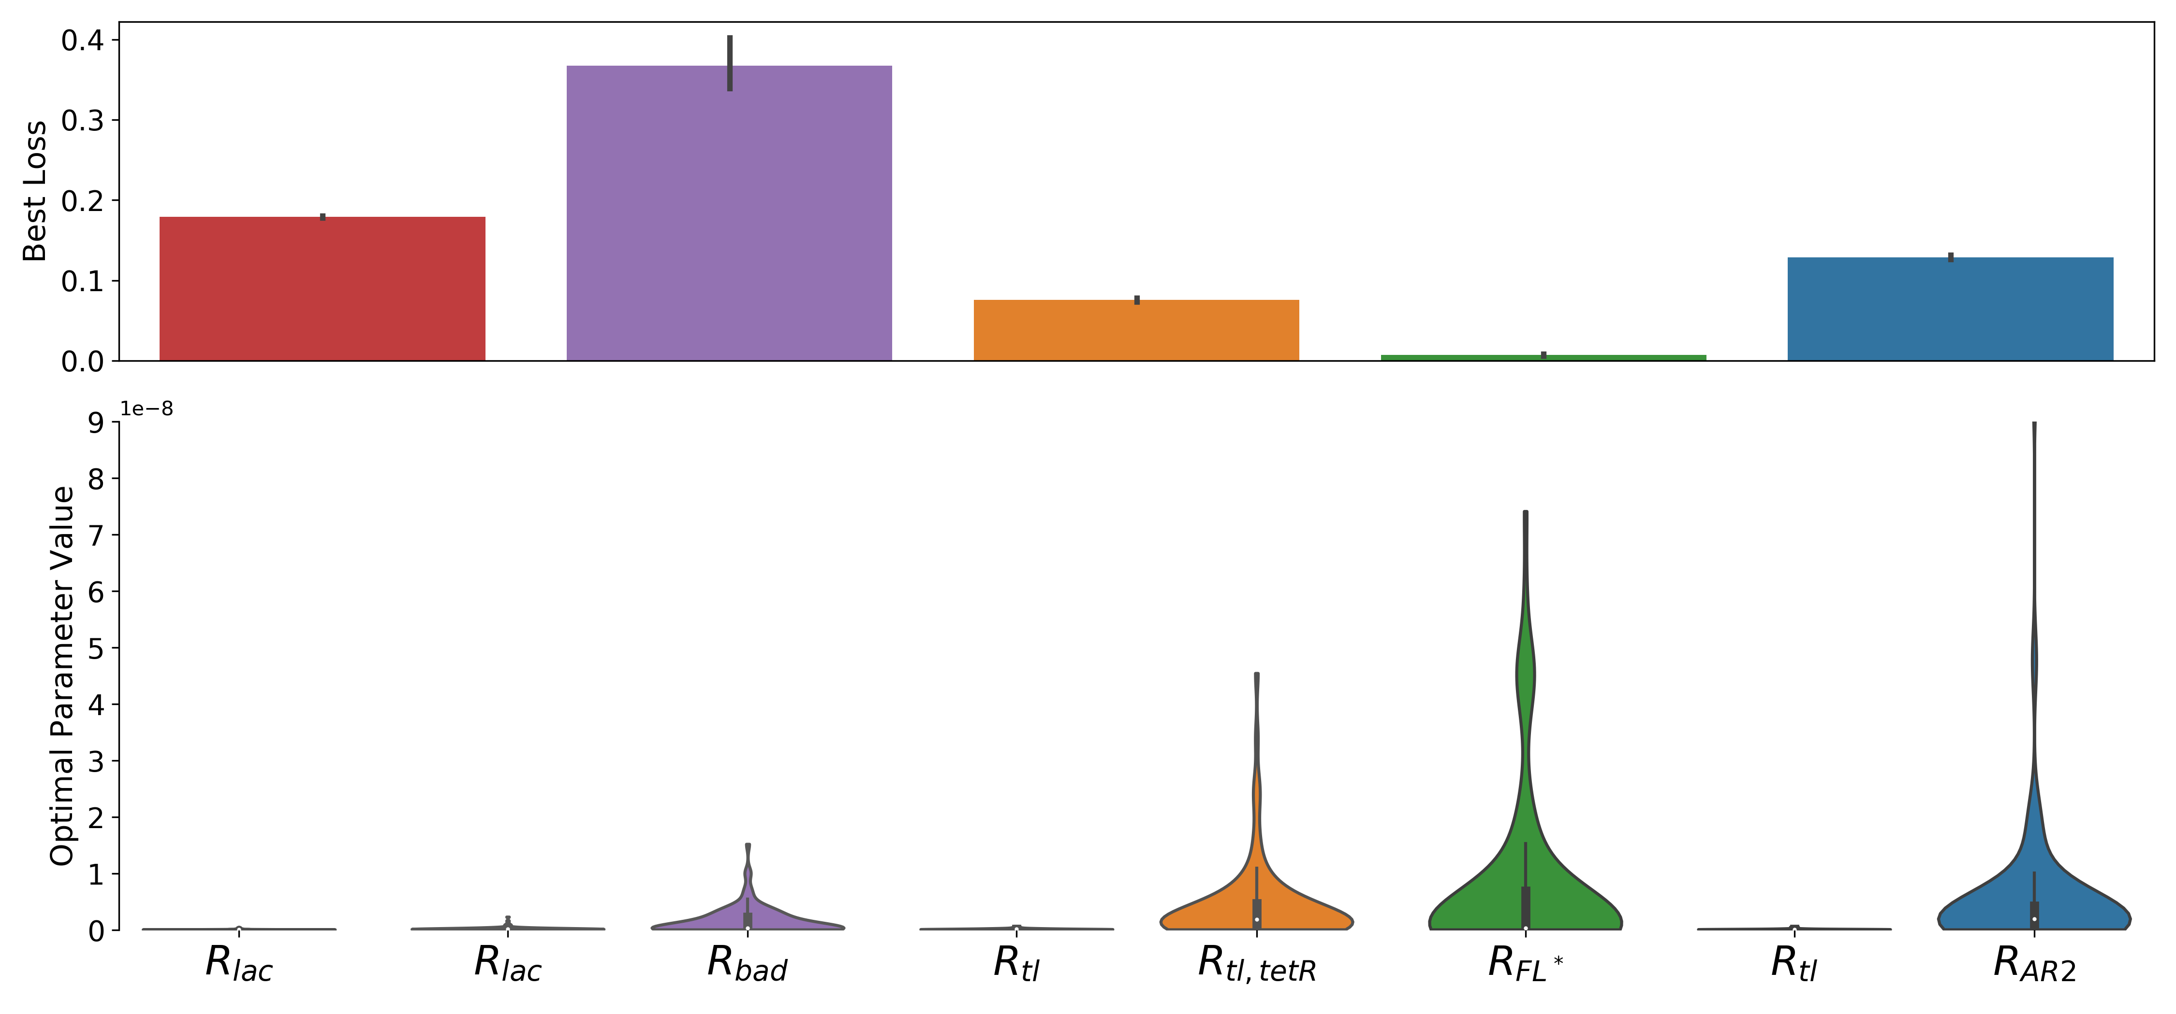
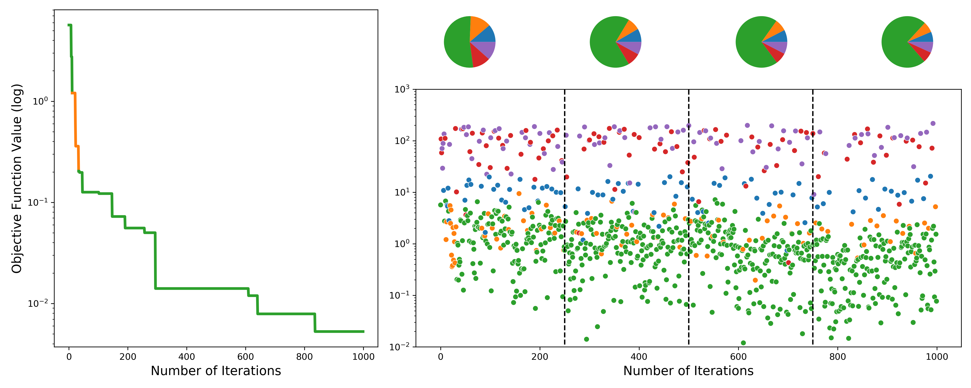
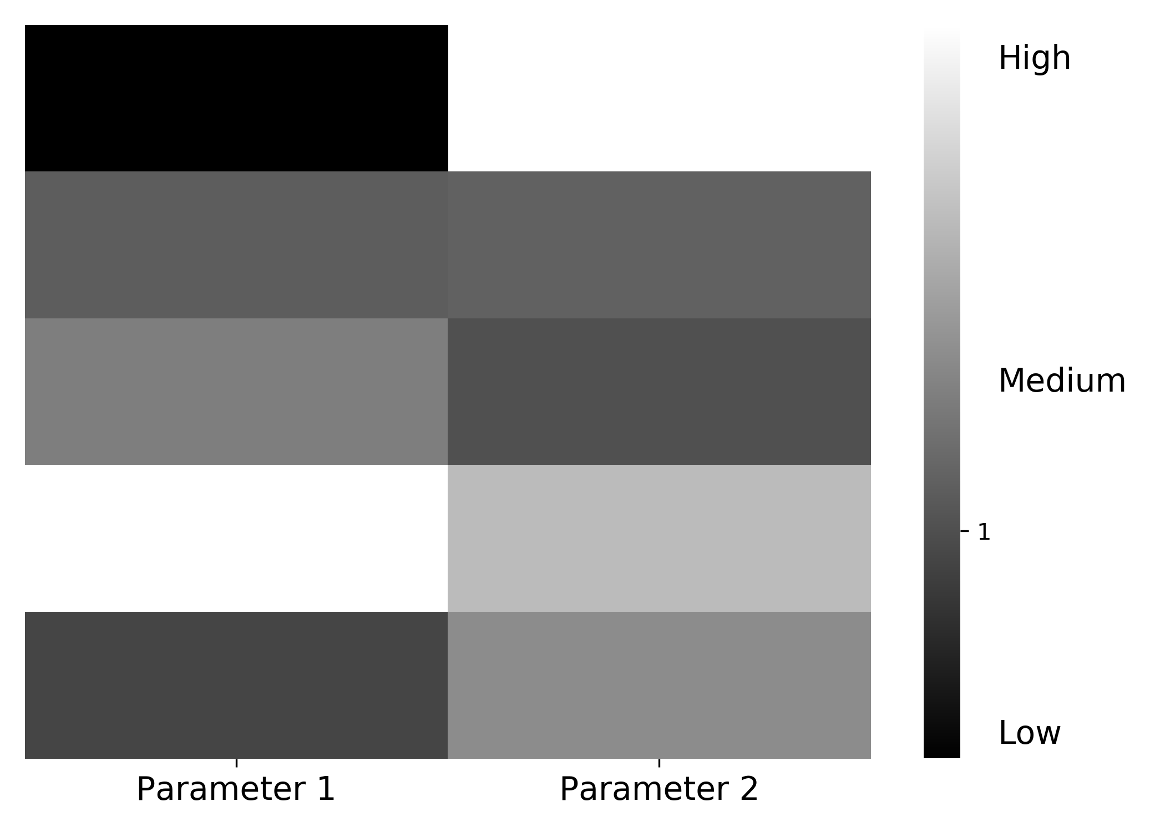
Notes:
Robustness score is invariant to mean. Instead, use coefficient of variation
Try violins/box plots for parameters
Bar plot with error bars

Slide 11
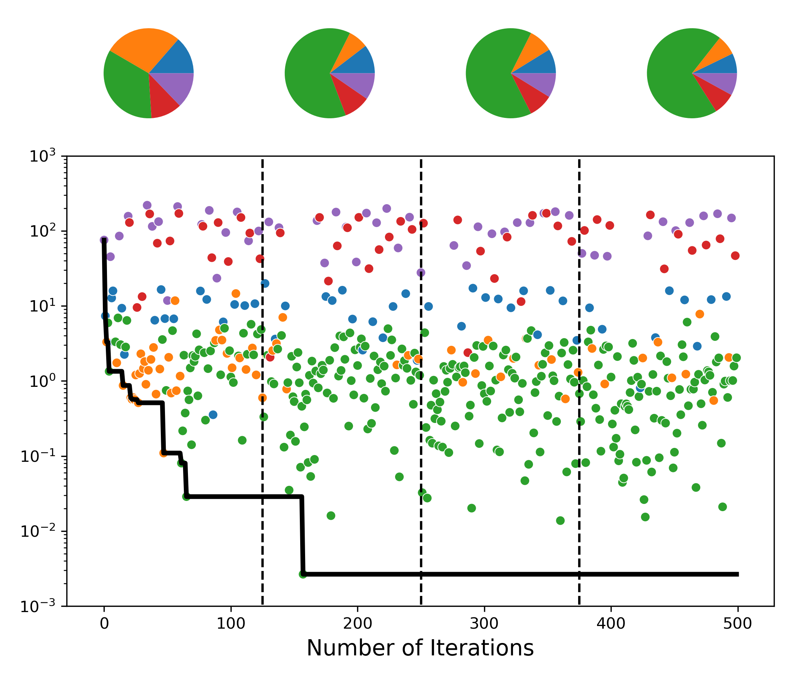
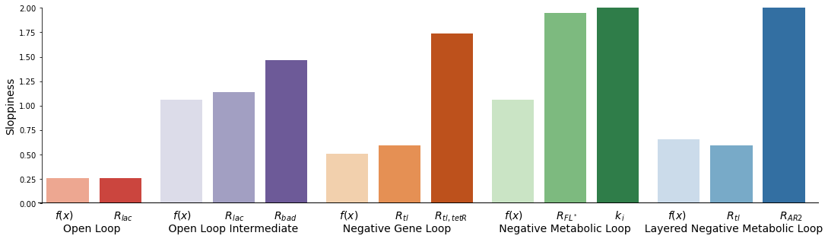
A
B
TF
E
E
E
V_{in}
V_{in}
V_{in}
S
P
S
P
S
P
$$μ$$
$$μ$$
$$μ$$
open loop
negative metabolic loop
negative gene loop
R
TF
E₁
E₂
E
V_{in}
V_{in}
S
P
I
S
P
$$μ$$
$$μ$$
C
open loop intermediate
layered negative metabolic loop

Slide 12
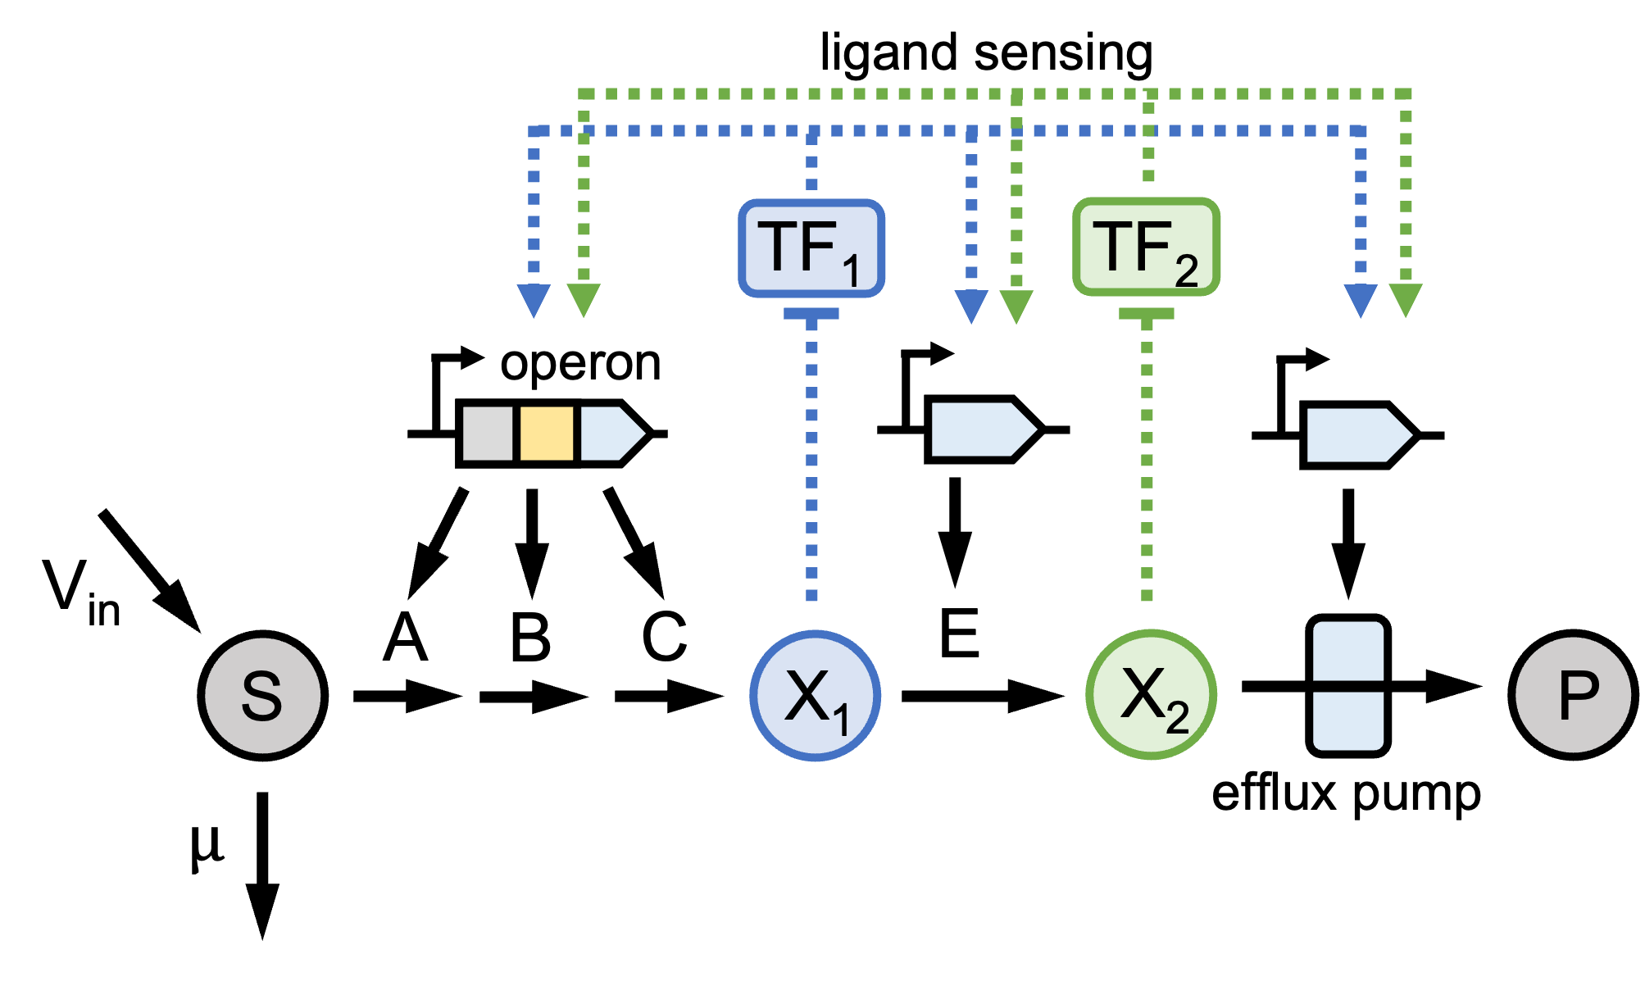
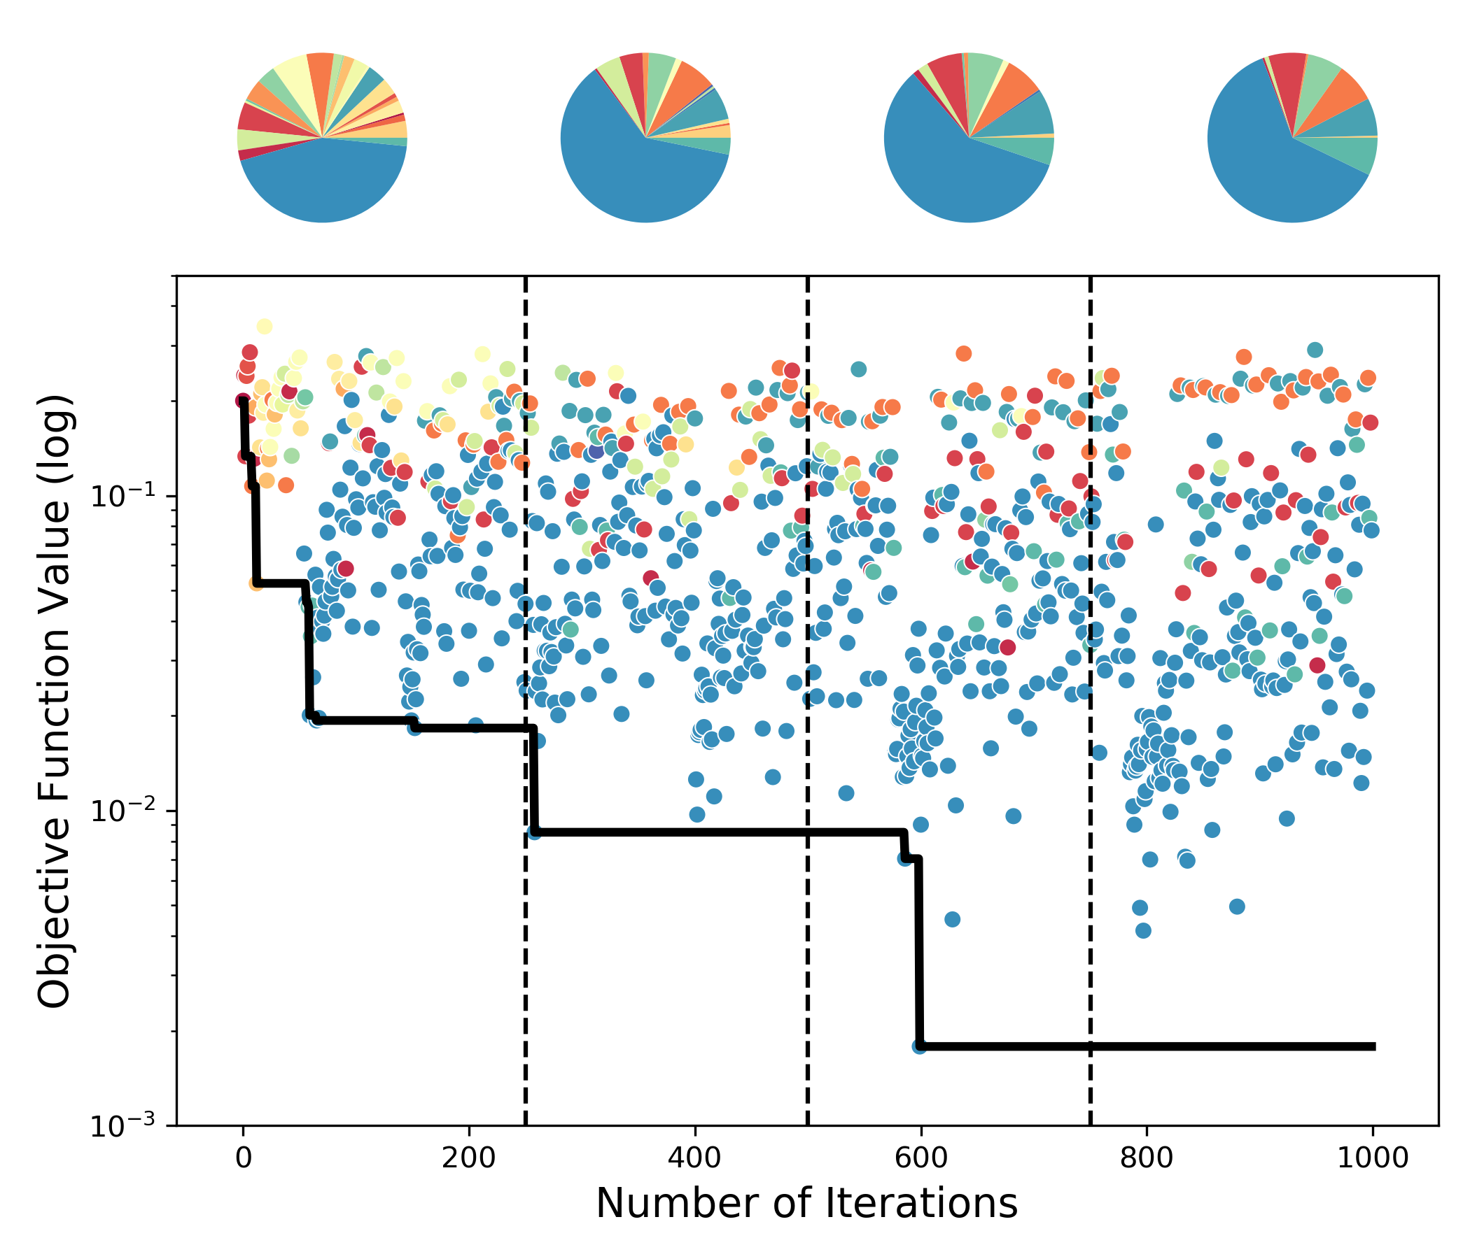
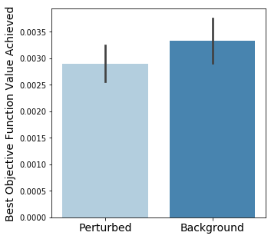
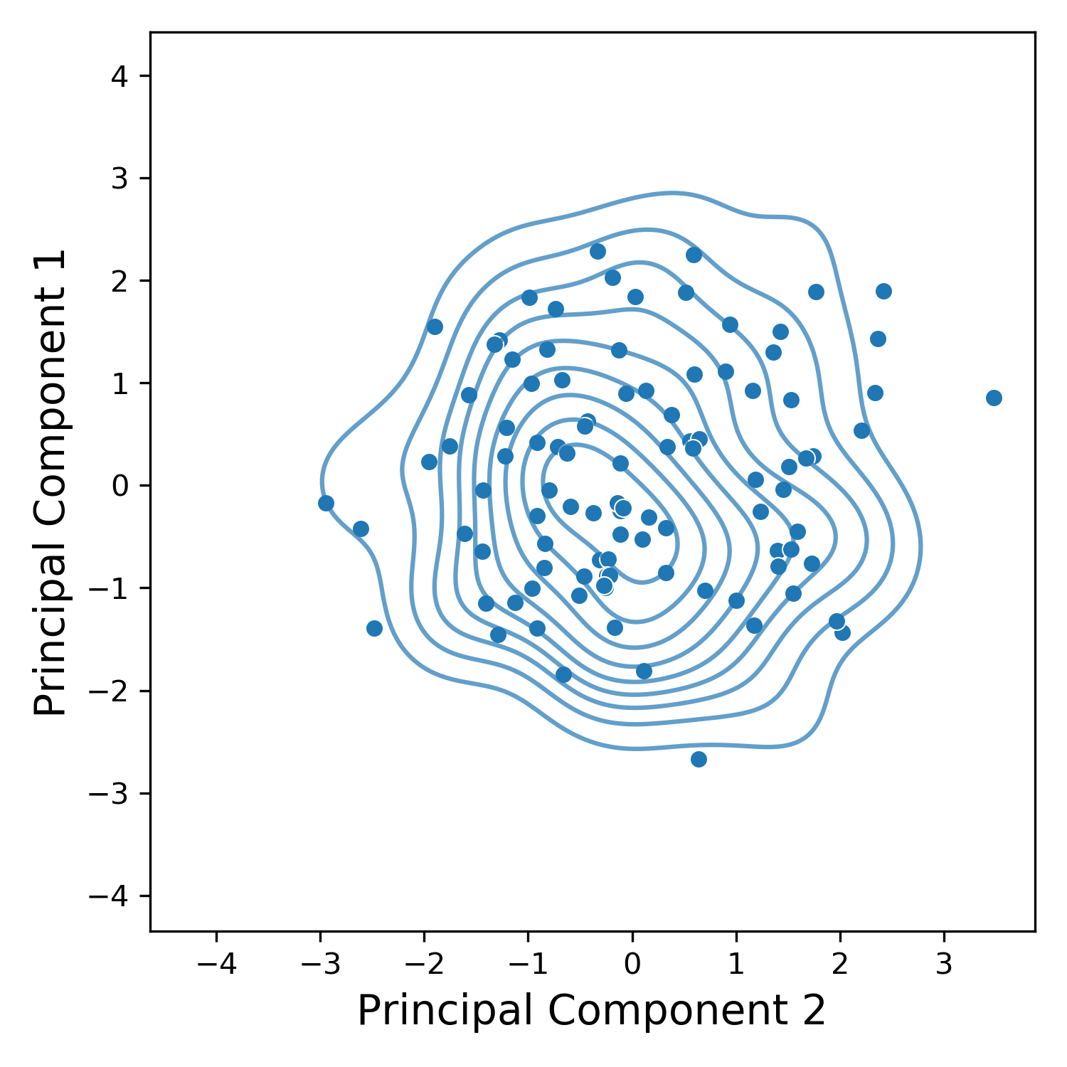
A
B
C
D

Slide 13
Supplementary Figures

Slide 14
Raw Figures

Slide 15
V_{in}
E₁
E₂
X_{o}
X₁
P
E₀
TF
TF
TF
open
loop
upstream
repression
downstream
activation
dual control

Slide 16
export
allostery
V_{in}
E₁
E₂
S
X
P
open loop
TF
native metabolism
E₁
E₂
E₁
E₂
E₁
E₂
…
X
…
X
…
X
TF
TF
TF
upstream repression
downstream activation
dual control

Slide 17
TF
E
E
E
V_{in}
V_{in}
V_{in}
S
P
S
P
S
P
$$μ$$
$$μ$$
$$μ$$
open loop
negative metabolic loop
negative gene loop
R
TF
E₁
E₂
E
V_{in}
V_{in}
S
P
I
S
P
$$μ$$
$$μ$$
open loop intermediate
layered negative metabolic loop

Slide 18

ligand sensing
TF₁
TF₂
operon
V_{in}
A
B
C
E
S
X₁
X₂
P
$$μ$$
efflux pump

